Slide 1

Welcome to all
for the Advertising Online lecture
Chapter 4- Brand building and Special Purpose of Adverting
By
Dr. Dhiraj Ovhal
HOD of Commerce

Slide 2
Write Meaning, Definition and Features of Advertising
Meaning:- The word advertising comes from Latin word “Advertere” which means to turn the mind towards .
The primary goal of advertising is to attract attention of audience and induce them to purchase advertising products and services.
Definition:- Definition AMA defines (American Marketing
Association)
“Any paid form of Non personal presentation,
Promotion of ideas, goods and service by an
indentified sponsor.”

Slide 3
Q.1 Write Advertising as communication process?
Meaning:-
Communication comes from Latin word “Communis” which means Common.
When we communicate we are trying to establish “Commonness” with someone.
Communication at least requires four elements such as Sender, the message, the Media and the receiver party.

Slide 4
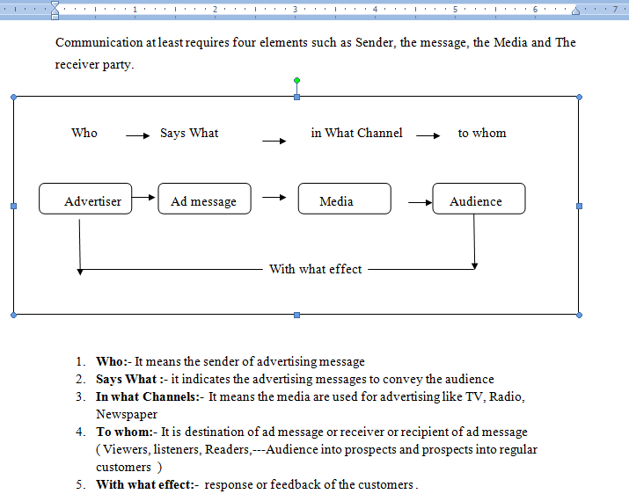

Slide 5
Who:- It means the sender of advertising message

Slide 6
1. The Sender (Encoder)
The sender of advertising message is the advertiser who wants to communicate commercial messages to the target audience. The sender encodes the ad messages and transmits them to the target audience through selected media.
To send effective messages, the advertiser has to plan and prepare creative ads. Certain factors to be considered in preparation of ads:
Nature of product
Ad messages by competitors
Nature of customers
Objectives of advertising, etc.

Slide 7
2. Says What :- it indicates the advertising messages to convey the audience

Slide 8
2. The Message:
The advertiser with help of ad agency comes up with creative advertising message. Through the advertising message, the advertiser aims to achieve the following objectives :
To create awareness.
To build or reinforce attitudes.
To create brand image.
To educate customers.
To provide information.
To persuade buyers.

Slide 9
3. In what Channels:- It means the media are used for advertising like TV, Radio, Newspaper

Slide 10
3. Medium:
The medium of communication refers to the media advertising. The media are the channels of communication through which ad messages are transmitted by the advert to the audience.
The most frequently used media are newspapers, TV, internet magazines, radio and Outdoor media. Each medium has its own distinct features and this is the reason that accounts for their survival and success in the competitive media world.

Slide 11
4.To whom:- It is destination of ad message or receiver or recipient of ad message
( Viewers, listeners, Readers,---Audience into prospects and prospects into regular customers )

Slide 12
The Receiver (Decoder): The recipients or audience of advertising messages include readers, listeners and / or viewers. The recipients may decode the ad message to understand it.
Advertising message is directed to either mass audience or to class audience. It is the desire of every advertiser to reach his message to maximum number of target audience. Every advertiser intends to convert audience into prospects and prospects into buyers.
The audience also includes dealers with whom the advertiser communicates to stock and promote the sale of his product. At times, the advertisements are directed to professionals like doctors, architects, professors, etc., so that they prescribe or recommend the products promoted by the advertiser. The advertiser may also communicate with the general public an other stakeholders.

Slide 13
5. With what effect:- response or feedback of the customers .

Slide 15
Thank You

Slide 16
Attendance Link
https://forms.gle/U4Da9ykpniL3tpCdA
(Mention date at last point)

